Slide 1
Kids stories
Presenter :
Jawaher Aljulaify , Jamila Alharbi
Instructor:
Dr. Mejdal Alqahtani

Slide 2
Table of contents
01
02
Introduction
Preprocessing
03
04
Models
conclusion

Slide 3
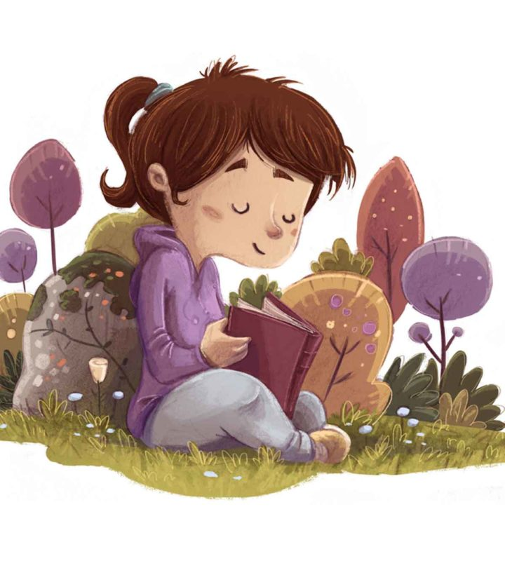
Introduction
Many parents fear that there kids will read stories that do not suit their ages , so we decided to make a model capable of classifying the appropriate stories and not for children.

Slide 4
Data
We do web scraping from (Qssas)
The dataset consists of 1020 Rows and 1 feature
Like :
أشرقت الشمس في الصباح ، وبدأت الطيور تغرد مثل كل يوم ، وأخذت الكتاكيت الصغيرة ، تلتقط الحبوب من الأرض ، وتجري هنا وهناك...

Slide 5
For Kids
inappropriate
Total number of stories
510
510

Slide 6
Preprocessing
Tokenization
Remove unnecessary information (stopping words, punctuation,…)
lemmatization using : qalsadi.lemmatizer
TD-IDF
Then we have 1020 rows and 11971 columns

Slide 7

LSA?
278
742
For Kids
inappropriate
Models
Oh no !!!!!!! , I think we need to change the data !!

Slide 8

NMF?
528
492
For Kids
inappropriate
Oh This is convenient, no need to change the data

Slide 9
Clustring with original data?
522
498
For Kids
inappropriate

Slide 10
Clustring with data after LSA?
523
497
For Kids
inappropriate

Slide 11
Clustring with data after NMF?
517
503
For Kids
inappropriate

Slide 12
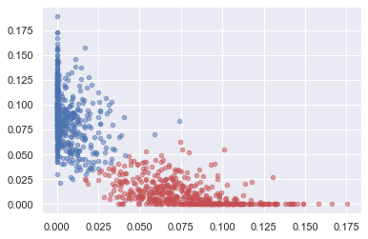
Represent of Clustring

Slide 13
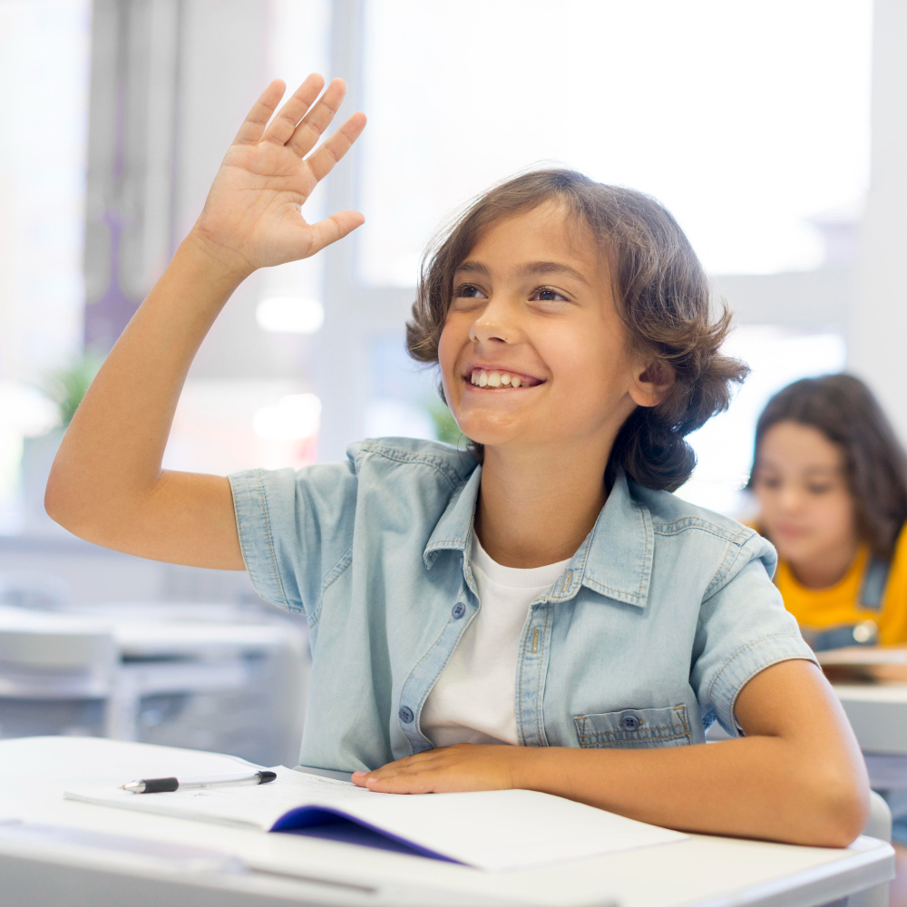
We want to check the accuracy of the model!
So, we added new data with Label to verify the accuracy of the model
34 appropriate for kids
34 inappropriate for kids

Slide 14
100%
We are glad that the model was able to classify the 68 stories correctly!!

Slide 15
conclusion
We've been able to make a model that can predict an appropriate stories for kids.
We hope to work on any content for children in future.

Slide 16
Time to have some fun

Slide 17


Slide 18
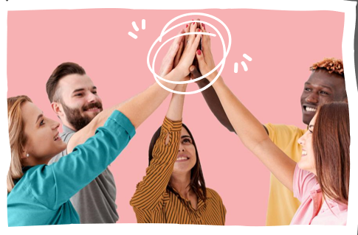
Thanks!

